Slide 1
University of Nebraska-Lincoln Testing Ag Performance Solutions (UNL-TAPS) 1st Annual Farm Management Competition
Daran Rudnick, Matt Stockton, Chuck Burr, and Rodrigo Werle
West Central Research and Extension Center
In Partnership with
Nebraska Water Balance Alliance (NEWBA)- Aquamart
Kick-Off Meeting: March 20th, 2017

Slide 2
Sponsors

Slide 3
Mission Statement
To engage forward looking agriculturalist to TAP into the UNLimited power of innovation, entrepreneurialism, technological adoption, improved techniques and methodologies to help Nebraska farm’s, farm businesses and farm families to maintain profitability and sustainability through the wise allocation and application of “all” their resources

Slide 4
Project Summary
The competition is about profitability, which of course requires attention to productivity and efficiency.
Each team or individual will be designated as a “Farm” which on paper includes 3,000 harvested acres for the purposes of making decisions, but will be imposed on 3 randomized plots (~0.5 acres)
Management decisions include:
Insurance selection, nitrogen management, hybrid selection, planting population density, irrigation scheduling, and marketing grain.
Management decisions will be submitted through internal website
Three Awards Provided
Most Profitable
Highest Input Use Efficiency
Highest Yield

Slide 5
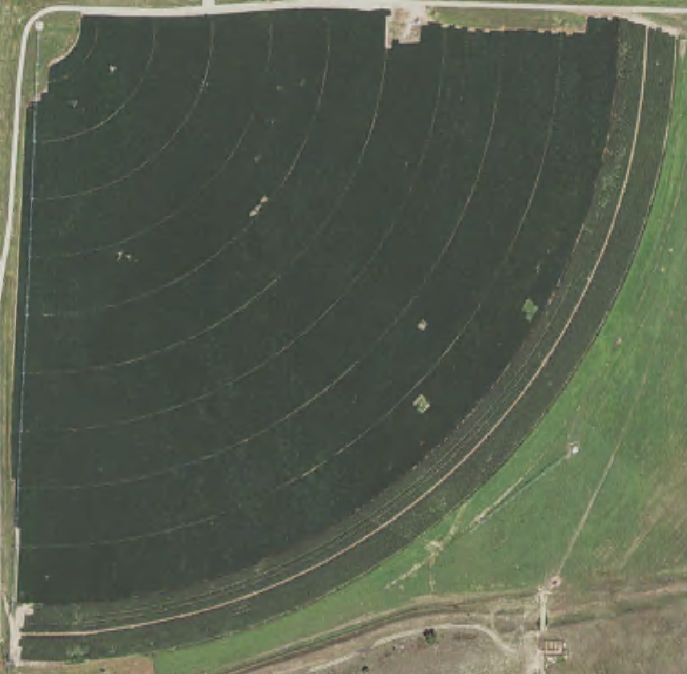
Site Description
West Central Research and Extension Center (WCREC) in North Platte, NE
Soil Type
Cozad Silt Loam
Climate
Semi-arid
Seasonal Rainfall
13.8 in
2017 Competition

Slide 6
Rules and Regulations
Operators are encouraged to visit and observe their “Farm”.
Operators may install equipment and/or collect additional data from their plots at their own expense (with approval), but the data must be made available to the organizing hosts.
Sensors, soil samples, plant samples, etc.
No additives, secret ingredients or soil, water or additional fertilizers or manures may be added to the plots
Individuals must confine their management to the set of listed parameters
Tampering or modifying any plot at the WCREC are grounds for disqualification.

Slide 7
Description of Awards
Will be Announced at the Annual Banquet (January 15th, 2018)
Most Economically Profitable
Amount = $2,000
Highest Input (Water and Nitrogen) Use Efficiency
Amount = $1,000
$Input Efficiency= \frac{\left({ET}_{Farm}−{ET}_{Control}\right)}{{Irrigation}_{Farm}}×\frac{\left({Grain N Uptake }_{Farm}− Grain {N Uptake }_{Control}\right)}{{Nitrogen Applied}_{Farm}}×\frac{{Yield}_{Farm}}{{Yield}_{Control}}$
Highest Grain Yield
Amount = $500 × (Percent of Most Profitable Farm)
Example: Farm 1 has highest yield, but only profited 78% of the most profitable farm.
$500 × 0.78 = $390

Slide 8
UNL-TAPS Contestant Agreement
I, ________________________ agree to actively participate in the University of Nebraska-Lincoln Testing Ag Performance Solutions (UNL-TAPS) event. I agree to participant in the various educational/promotional activities to further the stated goals of this project for the year of my entry and the following season to the best of my ability. Educational/promotional activities may include, but are not limited to the following:
News releases (e.g., UNL, CropWatch, Aquamart, etc.) Interviews (e.g., Nebraska Farmer, Market Journal, etc.)
Social media posts (e.g., Facebook, Twitter, Podcasts, etc.)
Practitioner panel discussions at educational programs
Walking Plot tours
The Awards Banquet
Other programs designed for consumer, producer and/or related business education
I agree to provide data, information and comments on my farm management strategies used while competing in the UNL-TAPS program. This information will NOT be used to identify any single producer but rather as a composite part of the whole data set of all producers.
As a participant, I agree to provide information to be used in news releases/stories/interviews/research papers. In some cases names will not be used to protect the individual’s identity.
As a participant, I agree to share what I have learned at various events (University, industry and governmental) workshops and field days, as time permits, to further the goals of the UNL-TAPS program. The UNL-TAPS executive team has the right to terminate my participation in the event at any time during the event year. The executive team is solely responsible for selecting participants and assigning plot areas to individuals.
Printed Name: ____________________________________
Signature: ____________________________________ Date:______________

Slide 9
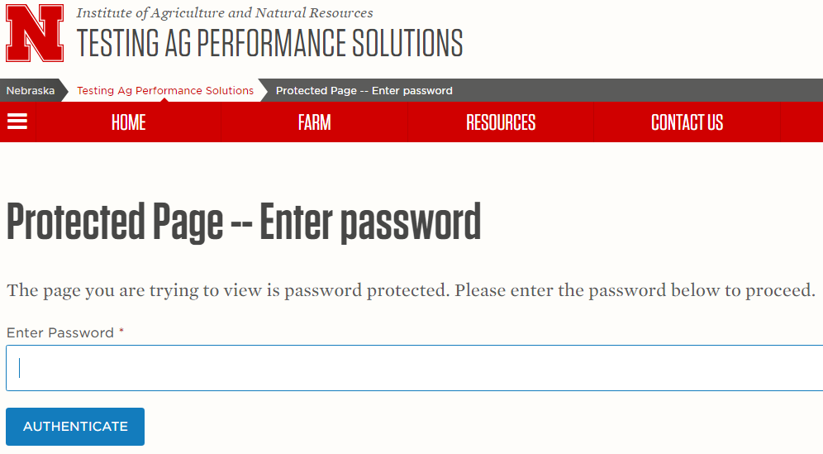
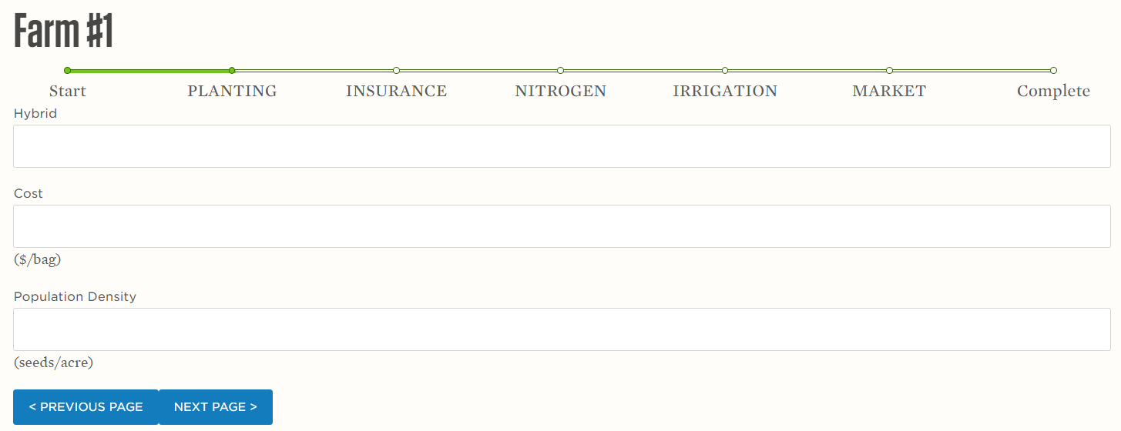
Management Decisions
Production Components
Hybrid Selection
Planting Population Density
Nitrogen Fertilizer Amount
Irrigation Scheduling
Economic Components
Insurance Selection
Marketing Grain

Slide 10
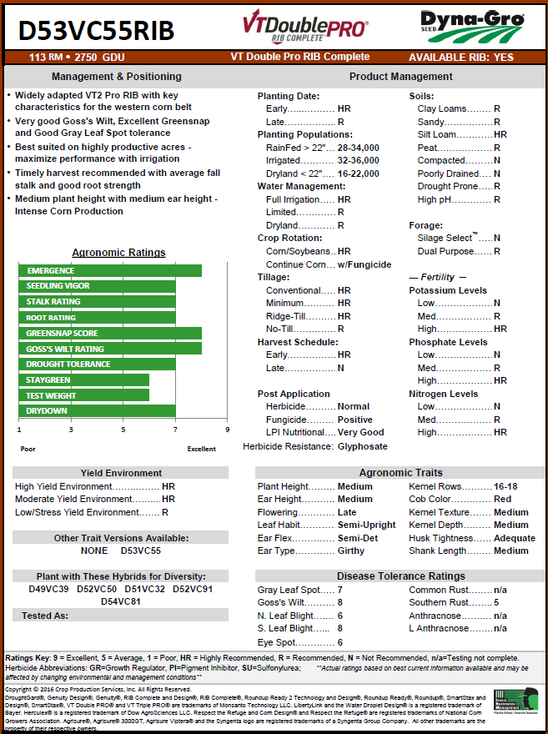
Hybrid Selection & Population Density
Default Hybrid ➔
Dyna-Gro D53VC55RIB
Cost: $217.80 per bag
Assuming: 12% bulk discount & 10% early purchasing discount
Supplying Your Own Hybrid?
Provide 10 lbs of seed by April 10th
Disclose cost per bag of seed
Planting Population Density
Deadline: April 10th

Slide 11
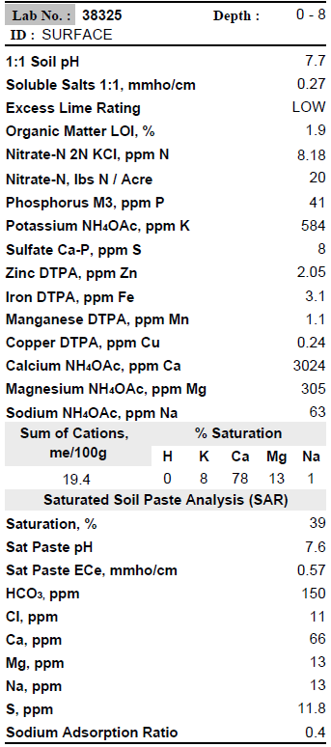
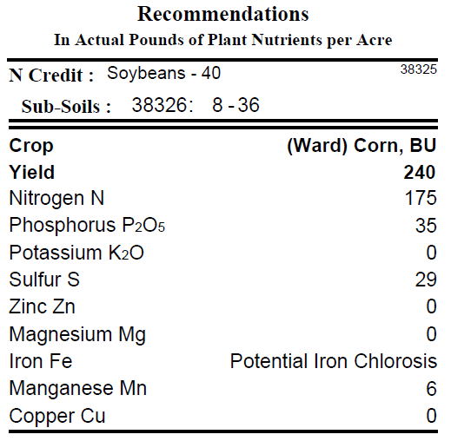
Nitrogen Fertilizer (UAN 32%)
Pre-plant
Deadline: March 31st
Method: Spray (broadcast)
Amount: 0 to 300 lbs/acre
Timing: April 3rd or earliest convenient date
Side-dress
Deadline: May 1st
Method: Spray (dribble or inject)
Amount: 0 to 150 lbs acre
Timing: V4 – V6
Fertigation
Initial Fertigation Plan Due: May 1st
Amount: 0 to 30 lbs/acre/event
Timing: V9, V12, VT/R1, & R2
Irrigation Depth: ~0.30 in/event

Slide 12
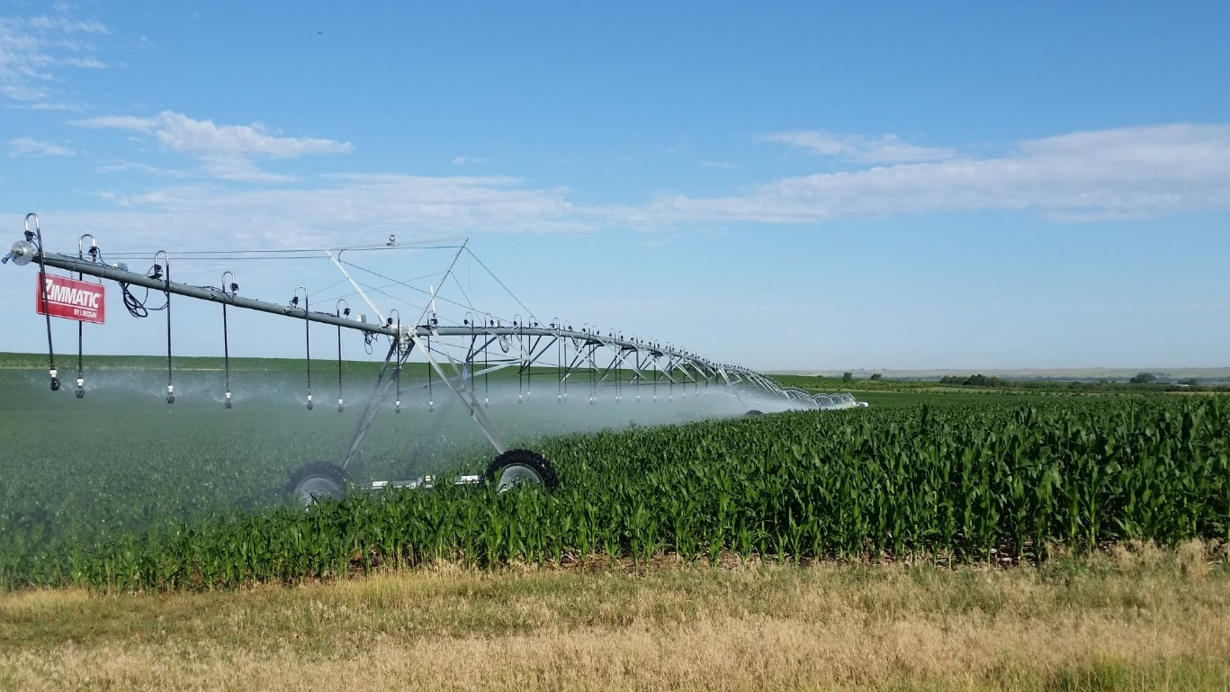
Irrigation Scheduling
Irrigation System will Operate on:
Monday
Thursday
Irrigation Depths:
0 to 1.0 inches per event
Decisions:
The participants will have until 10 AM on the irrigation days to note whether they would like to irrigate using the competition website (www.TAPS.unl.edu).
If participants fail to indicate their intent to irrigate by 10 AM, no irrigation water will be applied on that irrigation day.
Irrigation scheduling can be made one month in advance using the competition website.

Slide 13
Insurance Selection
Revenue Protection
Revenue Protection Harvest Price Exclusion
Yield Protection
65%, 70%, 75%, 80%
Hail Insurance
Wind Insurance

Slide 14
Marketing Grain
How many ways are there to win?
One method is to produce so cheaply that a low price results in a win
Achieve an average market price so high even a low production results in a win
The winner is likely to do both have lower cost production per unit and achieve a fairly high market value.
Marketing Methods:
Spot (Cash) Sales
Forward Contract
Basis Contract with Deliver at Harvest
Simple Hedge to Arrive
Futures Contract

Slide 15
Timeline: Management Decisions
Management Decisions
Insurance selection: March 31st
Pre-plant nitrogen amount (lbs/acre): March 31st
Hybrid selection and seed delivery: April 10th
Seeding rate: April 10th
Side-dress nitrogen amount (lbs/acre): May 1st
Intent to fertigate (yes or no) May 1st
Fertigation options available
V9, V12, VT/R1, & R2 According to crop progress
Irrigation Management Planting to Harvest
Marketing of Grain March 20th to Dec. 15th

Slide 16
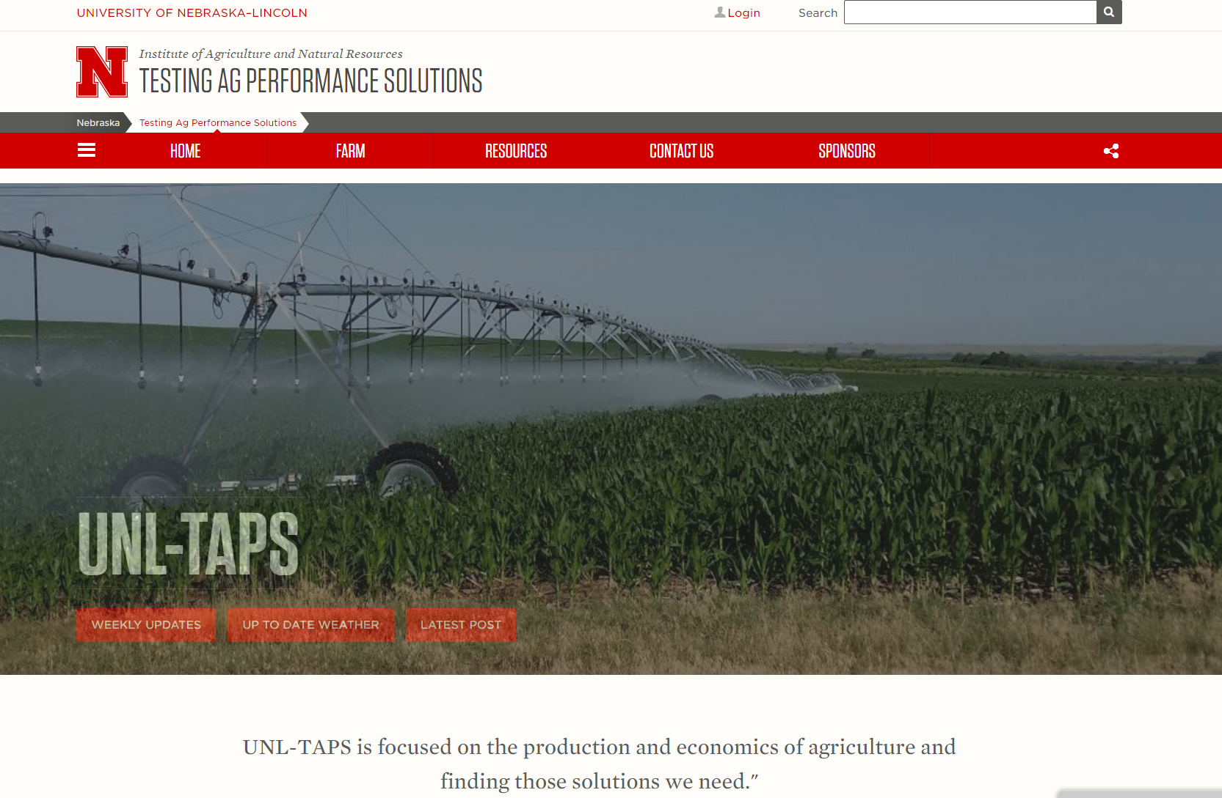
Thank You!
Website (www.TAPS.unl.edu)

